Slide 1
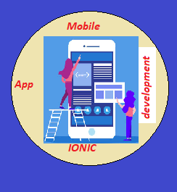
CAP489 MOBILE APP DEVELOPMENT FRAMEWORKS

Slide 2
Topics Covered
Ionic UI components:
action sheet, alert, badge, button, card, input, checkbox, radio, range, select, date and time pickers, images, list, menu

Slide 3
Action Sheet
An Action Sheet is a dialog which allows us to choose to confirm or cancel an action from a set of options.
Steps: import {ActionSheetController } from '@ionic/angular’;
Step2: constructor(
public actionsheetCtrl: ActionSheetController
) { }

Slide 4
Steps:
Step1: Create one new page and create one button in design part and call one function on button click.
<ion-button color="primary" (click)="clickMe()">Click Me!!</ion-button>
Step2: Open ts file and call module ActionSheetController
import {ActionSheetController } from '@ionic/angular’;
Step3:create instance for module ActionSheetController
constructor(
public actionsheetCtrl: ActionSheetController
) { }

Slide 5
Step4:Define function which is called on button click
Design Part:
<ion-header >
<ion-toolbar>
<ion-title>Dialogbox Example</ion-title>
</ion-toolbar>
</ion-header>
<ion-content>
<ion-item>
<ion-button color="primary" (click)="clickMe()">Click Me!!</ion-button>
</ion-item>
</ion-content>

Slide 6
Code of ts file:
async clickMe()
{
const actionSheet = await this.actionsheetCtrl.create({
header: 'Action Sheet',
buttons: [
{
text: 'Ok',
role: 'ok',
handler: () => {
console.log('Ok clicked');
}
},{
text: 'Cancel',
role: 'cancel',
handler: () => {
console.log('Cancel clicked');
}
}
]
});
await actionSheet.present();
}

Slide 7
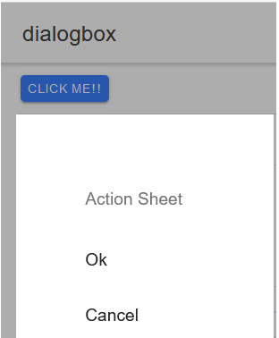

Slide 8
Alert dialog
An Alert is a dialog which is used to display any message or information with ok button. An alert appears on top of the app's content.

Slide 9
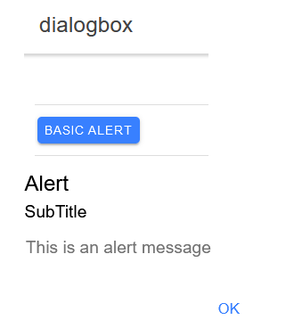

Slide 10
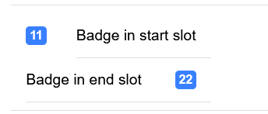
<ion-badge>
Badges are inline block elements that usually appear near another element. It contains a number or other characters. It is used as a notification that there are additional items associated with an element.

Slide 11

ion-range
The Range slider lets users select from a range of values by moving the slider knob. By default one knob controls the value of the range.

Slide 12
ion-datetime
Datetimes present a calendar control. User can select date and time using this component.

Slide 13
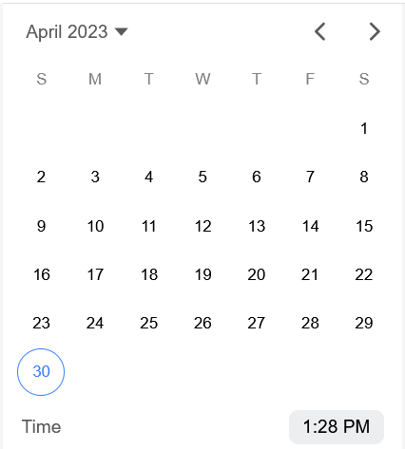

Slide 14
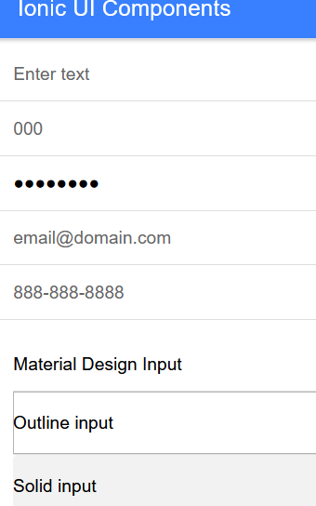

Slide 15
Ion-button:
Using this component we can create button make clickable to perform some action or task.

Slide 16
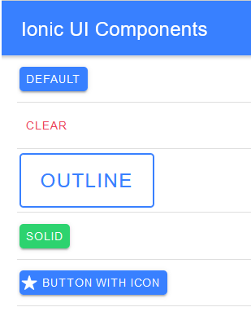

Slide 17
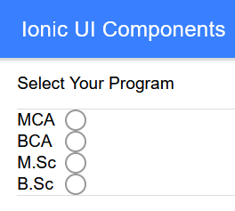
ion-radio

Slide 18
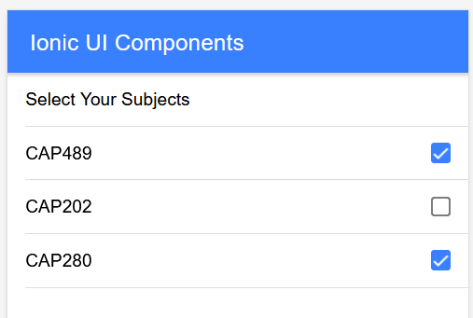

Slide 19
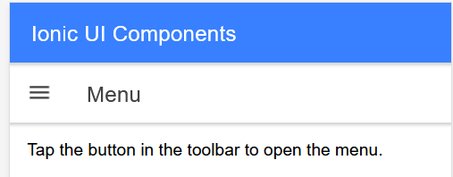

Slide 20
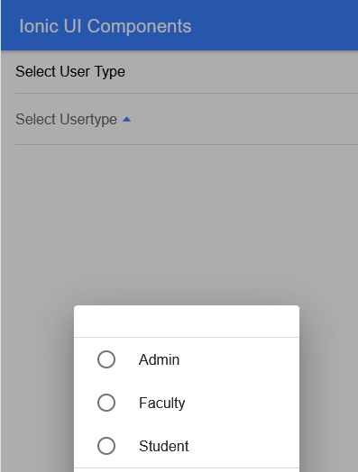

Slide 21
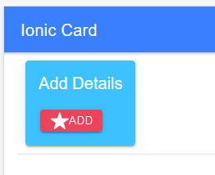

Slide 22


Slide 23
ion-img
Used to display image in ionic page.

Slide 24
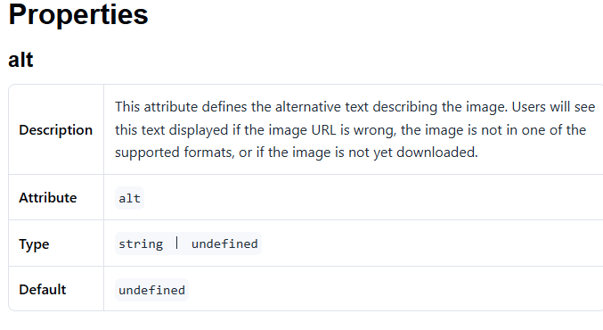

Slide 25
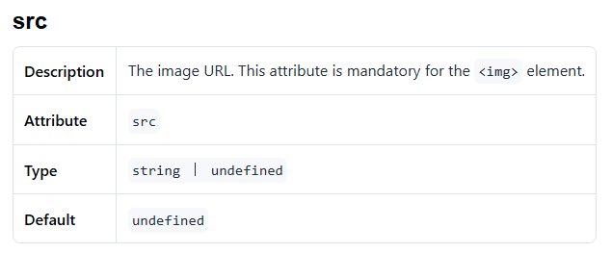

Slide 26
list
ion-list
Lists are made up of multiple rows of items which can contain text, buttons, toggles, icons, thumbnails, and much more. Lists generally contain items with similar data content, such as images and text.

Slide 27
menu
ion-menu
The Menu component is a navigation drawer that slides in from the side of the current view. By default, it slides in from the left, but the side can be overridden. The menu will be displayed differently based on the mode, however the display type can be changed to any of the available menu types. The menu element should be a sibling to the root content element. There can be any number of menus attached to the content. These can be controlled from the templates, or programmatically using the MenuController.

Slide 28
Any query?

